Slide 1
Predicting Protein-Protein Interactions using Machine Learning
Supervised By:
Dr. Sitanshu Shekhar Sahu
Vivek Raj Gupta - BE/10144/17
Chinmay Sharma - BE/10275/17
Nachiket Agni - BE/10425/17

Slide 2
Motivation
01
Aim of Research work
02
Datasets
03
Feature Extraction Methods
04
TABLE OF CONTENTS
Baseline Models
05
06
Our Approach: DNN-LightGBM
07
Results
08
References

Slide 3
01
MOTIVATION

Slide 4
Protein-protein interactions (PPIs) play an important role in cell life activities, including DNA synthesis, gene transcription and translation, immune response and enzyme catalysis.
However, the traditional experimental methods are time-consuming and costly.
Recent studies have shown the importance of understanding interactions of human proteins with other proteins. The coronavirus attacks human body by protein-protein interaction.

Slide 5
02
AIM OF RESEARCH WORK

Slide 6
We use Pseudo Amino Acid Composition (PseAAC) and Conjoint Triad (CT) for converting inconsistent protein sequence strings into numeric vectors.
Then use traditional ML models for final classification of Protein-Protein Interaction and establish a baseline for comparison.
Tweaked existing Deep Neural Network XGBoost (DNN-XGB) to get a different DNN-LightGBM model for conducting comparisons with baseline models.

Slide 7
Process Flow
Interacting
or
Not Interacting
Extract PPI pairs from fasta file
Apply feature extraction methods
Apply machine learning classification algorithms
PPI Pairs
Final Prediction
PPI Dataset
Numeric Feature Vector
JAN 14

Slide 8
03
DATASETS

Slide 9
Saccharomyces Cerevisiae : constructed by Guo et al., having 11,888 protein pairs, including 5594 interacting pairs and 5594 non-interacting pairs.
Helicobacter Pylori : constructed by Martin et al., containing 2,916 protein pairs (1,458 interacting pairs and 1,458 non-interacting pairs).
Notes:
Equally divided inter and non-inter such that class doesn’t get imbalance, and model might overfit if it isn’t balanced, thus, might favour one class.

Slide 10
04
FEATURE EXTRACTION METHODS

Slide 11
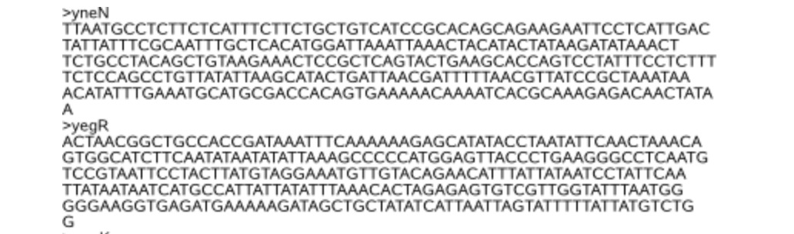
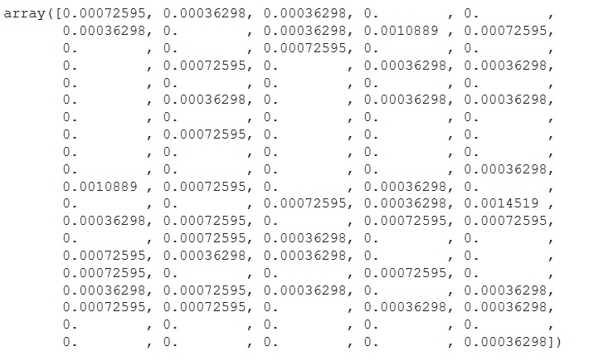
EXAMPLES OF PROTEIN SEQUENCES
Notes:
Screenshots of protein seq and feature vector
Seq id followed by prot seq from fasta file Part of a feat vect- comes from prot seq

Slide 12
Pseudo Amino Acid Composition
Pseudo amino acid composition (PseAAC) can represent amino acid composition information and amino acid order information.
It has been widely used in the field of bioinformatics, including protein site prediction, protein subcellular localization prediction, protein structure class prediction, protein submitochondrial prediction and so on.
Notes:
Arey kuch daal do feature extraction mein, mere paas bolne ko hai hi nahi zyada aisa lag raha
Cool, plot daalke isi mein likh dena, kya explain karna hai, dekh lenge subah

Slide 13
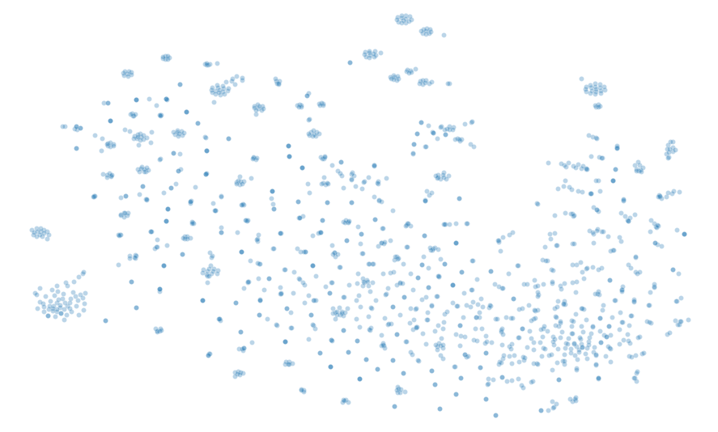
Plot of feature vectors obtained from PseAAC in 2D space
H. pylori dataset
Notes:
plotted feature vectors obtained from PseAAC in 2D space

Slide 14
Conjoint Triad
Electrostatic interactions (including interactions between hydrogen bonds) and hydrophobic interactions can have an effect on protein-protein interactions.
Electrostatic and hydrophobic interactions are affected by the dipoles and volumes of the amino acid side chains.
Conjoint Triad (CT) is based on dipoles and volumes physicochemical properties to extract effective information from protein sequences.

Slide 15
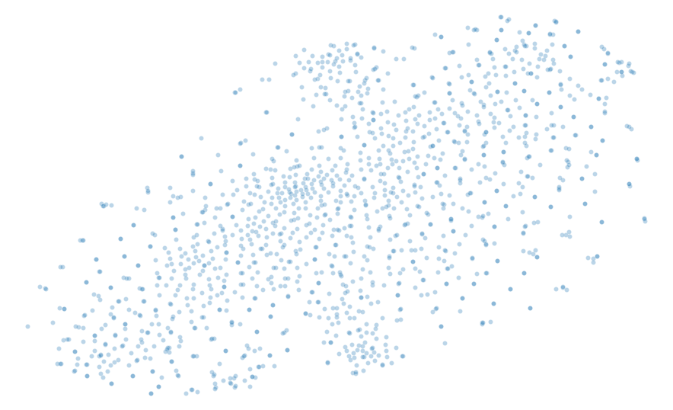
Plot of feature vectors obtained from CT in 2D space
H. pylori dataset
Notes:
plotted feature vectors obtained from conjoint triad in 2D space

Slide 16
05
Baseline Models

Slide 17
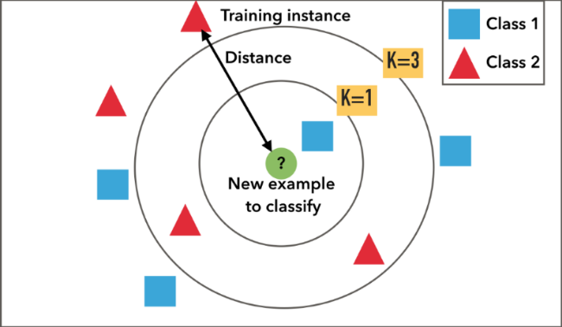
KNN Classifier
The k-nearest neighbors (KNN) algorithm is a supervised machine learning algorithm that can be used to solve both classification and regression problems.
The KNN algorithm assumes that similar things exist in close proximity. In other words, similar things are near to each other.

Slide 18
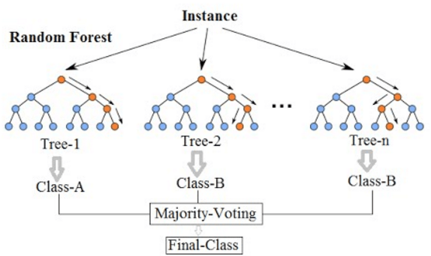
Random Forest Classifier
Random Forest is an ensemble learning method for classification, regression and other tasks that operate by constructing a multitude of Decision Trees at the time of training.
During classification task it outputs the class which is the Mode of classes predicted by individual trees.

Slide 19
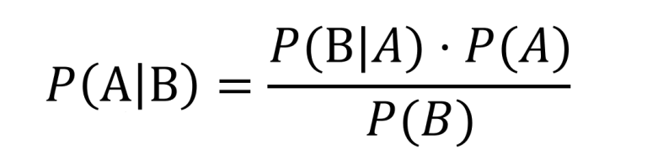
Naive Bayes Classifier
Naive Bayes classifiers are a collection of classification algorithms based on Bayes' Theorem.
It is not a single algorithm but a family of algorithms where all of them share a common principle, i.e. every pair of features being classified is independent of each other.
Bayes’ Theorem finds the probability of an event occurring given the probability of another event that has already occurred.

Slide 20

Support Vector Machine (SVM)
The objective of the SVM algorithm is to find a hyperplane in an N-dimensional space that distinctly classifies the data points.
To separate the two classes of data points, there are many possible hyperplanes that could be chosen.
Our objective is to find a plane that has the maximum margin, i.e the maximum distance between data points of both classes.

Slide 21
06
Our Approach:
DNN-LightGBM

Slide 22
Light-GBM
A LightGBM combines the predictions from multiple decision trees to generate the final predictions.
The nodes in every decision tree take a different subset of features for selecting the best split.
Additionally, each new tree takes into account the errors or mistakes made by the previous trees (boosting). So, every successive decision tree is built on the errors of the previous trees.

Slide 23
DNN-LightGBM
The Deep Neural Network (DNN) architecture is combined with LightGBM classifier to present a hybrid approach.
Post the subtraction operation we get the high-level abstract features.
The LightGBM classifier uses these features as input along with their class labels.
Finally, a LightGBM predictor is applied instead of neural network-based predictor in the DNN architecture.

Slide 24
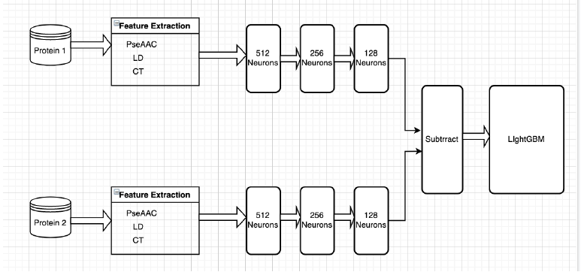

Slide 25
07
RESULTS

Slide 26
Prediction Performance on S. cerevisiae Dataset
(five fold cross validation)
CLASSIFIER | ACCURACY(%) | PRECISION(%) | RECALL(%)
K-Nearest Neighbor | 84.82 | 87.02 | 81.87
Random Forest | 90.39 | 94.37 | 88.04
Naive Bayes | 74.70 | 75.03 | 74.03
Support Vector Machine | 83.21 | 83.25 | 83.16
DNN-LightGBM | 93.13 | 94.90 | 90.72

Slide 27
Prediction Performance on H.pylori Dataset
(five fold cross validation)
CLASSIFIER | ACCURACY(%) | PRECISION(%) | RECALL(%)
K-Nearest Neighbor | 76.85 | 70.72 | 80.84
Random Forest | 81.38 | 81.90 | 80.80
Naive Bayes | 71.60 | 67.36 | 83.88
Support Vector Machine | 78.87 | 79.05 | 78.81
DNN-LightGBM | 91.70 | 90.67 | 92.70

Slide 28
08
REFERENCES

Slide 29
Chen, C., Zhang, Q., Ma, Q. and Yu, B., 2019. LightGBM-PPI: Predicting protein-protein interactions through LightGBM with multi-information fusion. Chemometrics and Intelligent Laboratory Systems, 191, pp.54-64.
Wang, Y., You, Z., Li, L., Cheng, L., Zhou, X., Zhang, L., Li, X. and Jiang, T., 2018. Predicting protein interactions using a deep learning method-stacked sparse autoencoder combined with a probabilistic classification vector machine. Complexity, 2018.
Zhou, Y.Z., Gao, Y. and Zheng, Y.Y., 2011. Prediction of protein-protein interactions using local description of amino acid sequence. In Advances in computer science and education applications (pp. 254-262). Springer, Berlin, Heidelberg.
Song, Y., Huang, J., Zhou, D., Zha, H. and Giles, C.L., 2007, September. Iknn: Informative k-nearest neighbor pattern classification. In European Conference on Principles of Data Mining and Knowledge Discovery (pp. 248-264). Springer, Berlin, Heidelberg.
Geng, H., Lu, T., Lin, X., Liu, Y. and Yan, F., 2015. Prediction of protein-protein interaction sites based on naive Bayes classifier. Biochemistry research international, 2015.
Qi, Y., Klein-Seetharaman, J. and Bar-Joseph, Z., 2005. Random forest similarity for protein-protein interaction prediction from multiple sources. In Biocomputing 2005 (pp. 531-542).
S.M, V.R.G, S.S.S, G.Panda. Deep neural network and extreme gradient boosting based hybrid classifier for improved prediction of protein-protein interaction. IEEE/ACM Transactions on Computational Biology and Bioinformatics, 2021.

Slide 30
THANKS
Does anyone have any questions?

